Slide 1
Problem statement
Implementation of an ordered list using Doubly Linked List

Slide 2
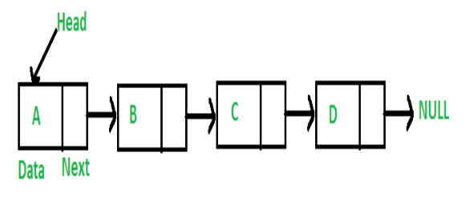
Link list
Like arrays, Linked List is a linear data structure. Unlike arrays, linked list elements are not stored at a contiguous location; the elements are linked using pointers.

Slide 3
Representation:
A linked list is represented by a pointer to the first node of the linked list. The first node is called the head. If the linked list is empty, then the value of the head is NULL. Each node in a list consists of at least two parts: 1) data 2) Pointer (Or Reference) to the next node
Link list Node can be represented as follows
struct node
{
int data;
struct node *next;
}

Slide 4
Types of Linked List
Following are the various types of linked list.
Simple Linked List − Item navigation is forward only.
Doubly Linked List − Items can be navigated forward and backward.
Circular Linked List − Last item contains link of the first element as next and the first element has a link to the last element as previous.

Slide 5
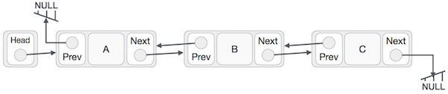
Doubly Linked List
A Doubly Linked List (DLL) contains an extra pointer, typically called previous pointer, together with next pointer and data which are there in singly linked list.

Slide 6
Following are the important points to be considered.
Doubly Linked List contains a link element called first and last.
Each link carries a data field(s) and two link fields called next and prev.
Each link is linked with its next link using its next link.
Each link is linked with its previous link using its previous link.
The last link carries a link as null to mark the end of the list.
Following is representation of a DLL node in C language.
/* Node of a doubly linked list */
struct Node
{
int data;
struct Node* next; // Pointer to next node in DLL
struct Node* prev; // Pointer to previous node in DLL
};

Slide 7
Basic operations provided by Doubly Linked List
Insertion − Adds an element at the beginning of the list.
Deletion − Deletes an element at the beginning of the list.
Insert Last − Adds an element at the end of the list.
Delete Last − Deletes an element from the end of the list.
Insert After − Adds an element after an item of the list.
Delete − Deletes an element from the list using the key.
Display forward − Displays the complete list in a forward manner.
Display backward − Displays the complete list in a backward manner.
Search – Searched for a given element in the list.

Slide 8
Program logic
Create a node to be inserted, fill in the data field and link field as NULL initially.
newnode = (struct node*)malloc(sizeof(struct node));
newnode->data = value;
newnode->next = NULL;
newnode->prev = NULL;
Check if the node to be inserted is first node in the list if so newnode becomes first node in the list. Otherwise goto step 3.
head = newnode

Slide 9
3. Find the proper position of node to be inserted and insert the node such that resulting link list is in ascending order.
if(newnode->data < head->data)
{
newnode->next = head;
head = newnode;
}
else
{
start=head;
curr=head->next;
while(curr && item > curr->data)
{
start=start->next;
curr=curr->next;
}//end of while
newnode->next=curr;
newnode->prev=start;
start->next=newnode;
}

Slide 10
4. Display all the nodes in the link list.
struct node *temp;
temp=head;
while(temp !=NULL)
{
printf("%d",temp->data);
temp=temp->next;
}

